Slide 1
How to Identify & Prevent the Risk of Falls National Fall Prevention Awareness Day
YOUR NAME, DATE OF PRESENTATION
AND CREDENTIALS HERE

Slide 2
Acknowledgements
Developed By:
Heidi Moyer, PT, DPT*†
Edited By:
Haim D. Nesser, PT, DPT†
Materials referenced by previous efforts from:
Jennifer Vincenzo, PT, MPH, PhD*
Mariana Wingood, PT, DPT*
Deborah Constantine, PT, DPT*†
Andrew Thomas, PT, DPT⧪
* Board Certified Clinical Specialist in Geriatric Physical Therapy (GCS)
⧪ Board Certified Orthopedic Clinical Specialist (OCS)
† Certified Exercise Expert for Aging Adults (CEEAA)

Slide 3
Objectives
Understand the impact of falls on older adults
Recall at least 3 factors that increase fall risk
Assess individual fall risk factors using the CDC STEADI Stay Independent Brochure

Slide 4
Objectives
List at least 2 resources available to them in the community to prevent falls
Identify when it is appropriate to access physical therapy services in relation to balance and falls issues

Slide 5
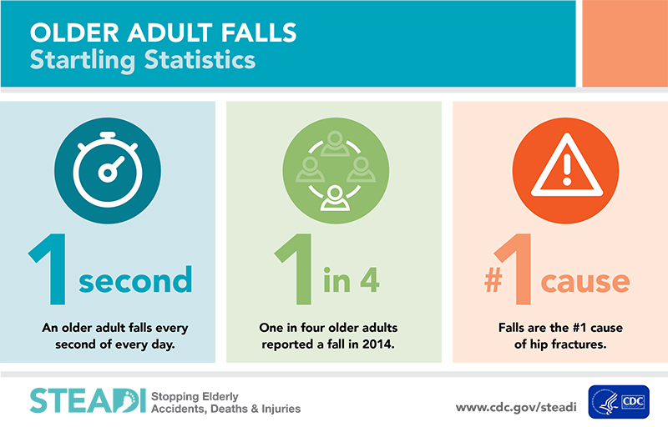
How Prevalent are Falls?
Every year, 3 million older adults are treated in ER for fall related injuries
$50 billion annually

Slide 6
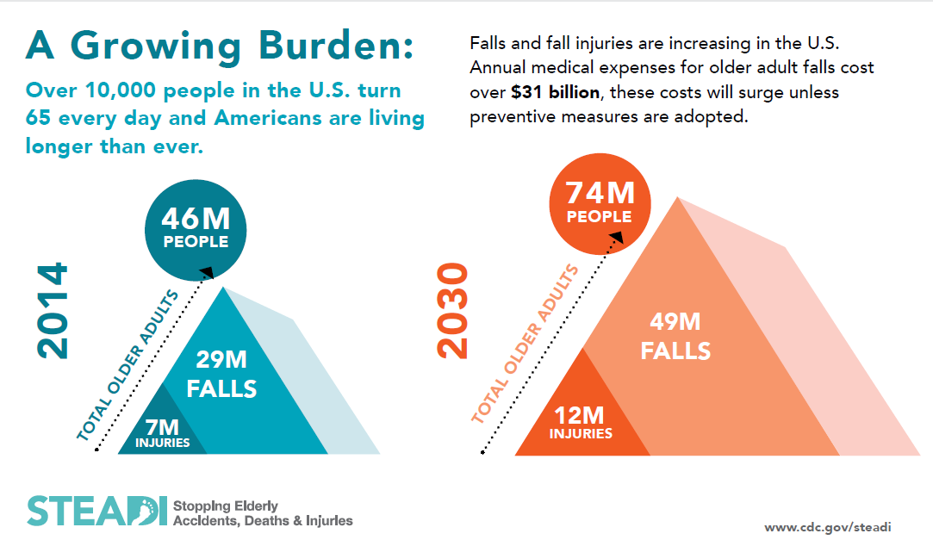
How Prevalent are Falls?
Average hospital cost: $30,000
Does not account for disability, dependence on others, lost time from work and household duties, and reduced quality of life
Fall death rates increased 30% from 2007 to 2016

Slide 7
By A Show Of Hands…
How many of you know someone who suffered from a fall?
How many of those people had life-changing issues as a result of the fall?
How many of you are afraid of falling?
How many of you have suffered a fall?
How many of you have had life-changing issues as a result of the fall?
Notes:
Poll the audience, have a dialogue with them.
*Write down the number of people who answer yes to the questions.
If you need to facilitate more participation, give an experience of an older adult you know who suffered a fall and the consequences (fracture, hospitalization, loss of independence, nursing home placement … ) etc.
Encourage sharing of stories

Slide 8
True or False: A fall only counts when you hit the ground.
False!
Notes:
FALSE! If you land on a wall, chair, or bed you are

Slide 9
Definition of a Fall
A fall IS defined as an event that leads to an unplanned, unexpected contact with a supporting surface.
Refers to even ‘falling’ into a chair or wall and not to the ground
A fall IS NOT the result of:
A push or shove
A medical event
Passing out
Suffering a stroke
Notes:
Shumway-Cook A, Baldwin M, Polissar NL, Gruber W. Predicting the Probability for Falls in Community-Dwelling Older Adults. Physical Therapy. 1997;77(8):812-819. doi:10.1093/ptj/77.8.812.
Clarify with the patient the circumstances surrounding the fall.
No single event caused the fall. No injury has to be sustained.
Fall: unintentional loss in balance that leads to failure of postural stability” or sudden and unexpected change in position which usually results in landing on the floor.”
Nelson, R, Amin, M: Falls in the elderly. Emerg Med Clin North Am. 8, 1990, 309–324
Recurrent fallers: those who have fallen 2 or more times in the wither 6 or 12 months

Slide 10
Types of Falls
Notes:
Shumway-Cook A, Baldwin M, Polissar NL, Gruber W. Predicting the Probability for Falls in Community-Dwelling Older Adults. Physical Therapy. 1997;77(8):812-819. doi:10.1093/ptj/77.8.812.

Slide 11
Physical Consequences of Falls
In older adults who fall, the following can occur…
Hip fracture 37.9%
Loss of mobility 20.6%
Loss of independence 13.7%
Depression 10.3%
Arm injuries 5.7%
Death 21.8%
Notes:
Terroso M, Rosa N, Torres Marques A, Simoes R. Physical consequences of falls in the elderly: a literature review from 1995 to 2010. European Review of Aging and Physical Activity. 2013;11(1):51-59.

Slide 12
Fear of Falling
Fear of Falling is a lasting concern about falling that may cause a person to stop doing activities he/she remains able to do.
Are you afraid of falling?
Do you limit or avoid activities you used to do to be more careful?
*Fear of falling increases fall risk*
Notes:
When asked, “Are you afraid of falling?”—many people will say, “No, I’m not afraid, I’m just more careful.” A fear of falling is defined as a lasting concern about falling that may cause a person to stop doing activities s/he remains able to do.
For instance if a person doesn’t go to the store or church anymore or stays in most of the winter because of concerns about a slip on ice, then the ice and fear of falling is limiting their activities and social interaction. This fear of falling is in itself a risk factor for falls.
You may poll the audience again if you think it is appropriate.

Slide 13
Fear of Falling
Past falls are a risk factor for additional falls
Increased Weakness
Fall
Decreased Activity
Fear of Falling
Fear of Moving
Notes:
As a result of previous falls, older adults may develop a fear of falling, decreased physical activity, and/or social isolation. Renfro et al 2016,
-- State to the audience - If an older adult restricts or avoids activities to avoid a fall, they are still at increased risk of falling.

Slide 14
Why Does Fear of Falling Matter?
May stop you from activities
Legs weaken with less activity
May cause you to feel depressed or lonely
*All of these increase your risk of falling*
www.ncoa.org
Notes:
Boyd R, Stevens JA. Falls and fear of falling: burden, beliefs and behaviours. Age Ageing. 2009;38(4):423-428.
So why does a fear of falling matter to us? Well it can stop a person from doing some of their favorite activities that are important to their mental and physical health.
If you stop doing activities you enjoy, this can lead to feeling depressed or lonely.
Fear of falling can lead to inactivity. When we sit, we lose the muscles that we need to use to stand, keep our balance, walk, and move.

Slide 15
By A Show Of Hands…
Is the definition of a fall different than what you thought it was?
Does this change your answer on if you have fallen in the past year?
Did you tell your primary care provider?
Do you feel unsteady when standing or walking?
Did you know a previous fall increases your future fall risk?
Notes:
Poll the audience, have a dialogue with them.
*Write down the number of people who answer yes to the questions.
If you need to facilitate more participation, give an experience of an older adult you know who suffered a fall and the consequences (fracture, hospitalization, loss of independence, nursing home placement … ) etc.
Encourage sharing of stories

Slide 16
True or False: Falls are a normal part of aging?
False!
Notes:
FALSE! Falling is not a normal part of aging and is the result of abnormal aging.

Slide 17
True or False: Falls are preventable.
True!
Notes:
True! Most falls are preventable if you know where to start!

Slide 18
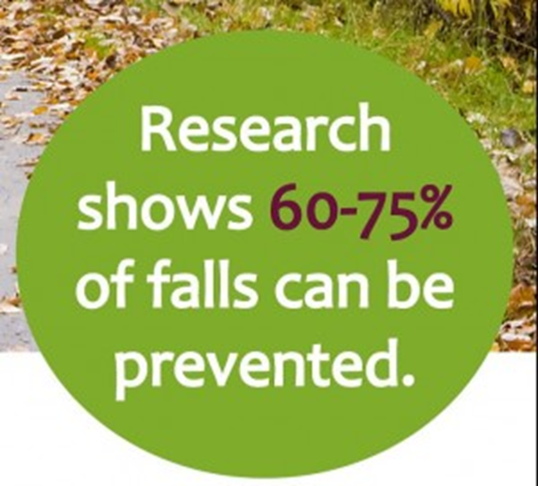
Are Falls Preventable?
Notes:
The good news is – yes, falls are largely preventable with simple measures. Come learn how.
Notes for presenters to keep in mind, but don’t necessarily need to state:
Falls are experienced by many older adults—a common experience; managing fall risk is a “normal” part of aging. However, falls themselves are NOT a normal part of aging.

Slide 19
Types of Risk Factors
Modifiable Risk Factors
Non-Modifiable Risk Factors
Risk factors that can be easily changed or modified
Risk factors that cannot be easily changed or modified
Notes:
Renfro M, Maring J, Bainbridge D, Blair M. Fall Risk Among Older Adult High-Risk Populations: a Review of Current Screening and Assessment Tools. Current Geriatrics Reports. 2016;5(3):160-171.

Slide 20
Non- Modifiable Risk Factors
Age >65
History of falls
Female gender
Polypharmacy (taking more than 4 medications)
Poor vision (but you can help it by optimizing your vision!)
Notes:
Renfro M, Maring J, Bainbridge D, Blair M. Fall Risk Among Older Adult High-Risk Populations: a Review of Current Screening and Assessment Tools. Current Geriatrics Reports. 2016;5(3):160-171.

Slide 21
Non- Modifiable Risk Factors
Poor feeling in feet/legs
Ethnicity: White/Asian > African American/Hispanic
Chronic disease diagnosis
Memory Deficits (ex: Alzheimer’s Disease)
Notes:
Renfro M, Maring J, Bainbridge D, Blair M. Fall Risk Among Older Adult High-Risk Populations: a Review of Current Screening and Assessment Tools. Current Geriatrics Reports. 2016;5(3):160-171.

Slide 22
Modifiable Risk Factors
Internal Risk Factors
Physical inactivity
Leg weakness
Poor balance
Improper use of cane or walker
Medication issues/errors
Low blood pressure when changing positions
Poor vision care/correction
Fear of falling/depression
Social isolation
Notes:
Renfro M, Maring J, Bainbridge D, Blair M. Fall Risk Among Older Adult High-Risk Populations: a Review of Current Screening and Assessment Tools. Current Geriatrics Reports. 2016;5(3):160-171.

Slide 23
Modifiable Risk Factors
External Risk Factors
Stairs – uneven or not having rails
Trip hazards
Unsecured throw rugs
Lack of grab bars in bathrooms
Low chairs/toilets/sofas
Notes:
Renfro M, Maring J, Bainbridge D, Blair M. Fall Risk Among Older Adult High-Risk Populations: a Review of Current Screening and Assessment Tools. Current Geriatrics Reports. 2016;5(3):160-171.

Slide 24
Modifiable Risk Factors
External Risk Factors
Poor lighting
Cabinets and storage not easy to reach
Narrow doorways and/or paths limit use of needed assistive devices
Uneven or wet surfaces
Notes:
Renfro M, Maring J, Bainbridge D, Blair M. Fall Risk Among Older Adult High-Risk Populations: a Review of Current Screening and Assessment Tools. Current Geriatrics Reports. 2016;5(3):160-171.

Slide 25
How Can You Prevent a Fall?
Know your risk factors!
Take the quiz in the CDC Stay Independent Brochure
Notes:
At this time either refer people to the Stay Independent Brochure hand out you have provided or use the link above to go to the website to take the quiz together.

Slide 26
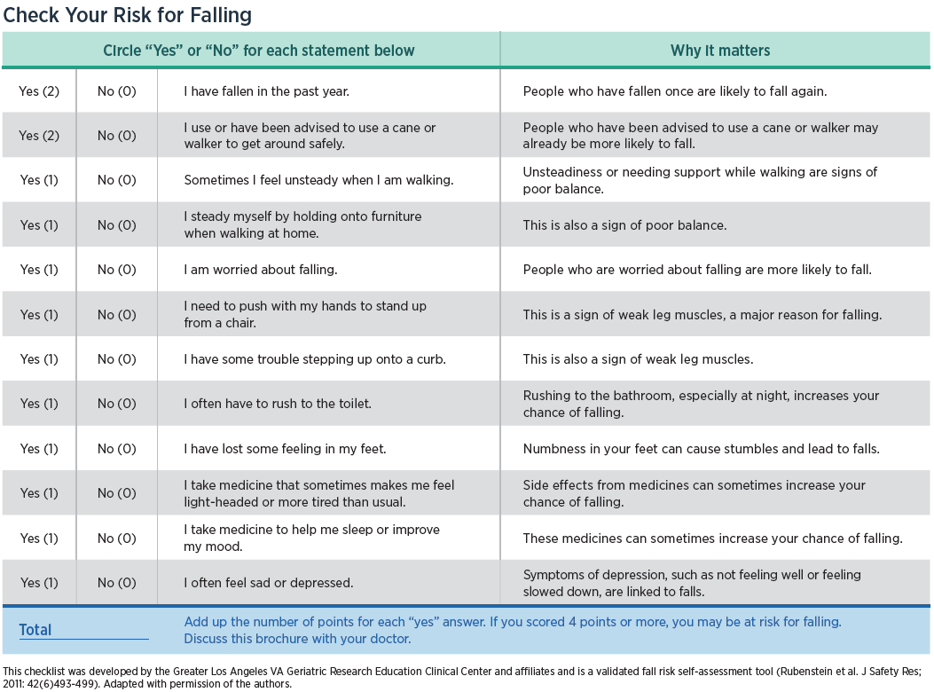
Stay Independent Brochure

Slide 27
How can I prevent a fall?
Notes:
FALSE! Falling is not a normal part of aging and is the result of abnormal aging.

Slide 28
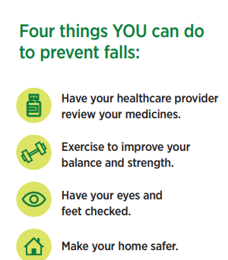
Preventing Falls
Check your risk early and often
Don’t wait for a fall to occur!
Address any factors that place you at a risk of falls
If you have a change in our movement ability, consult a physical therapist immediately.

Slide 29
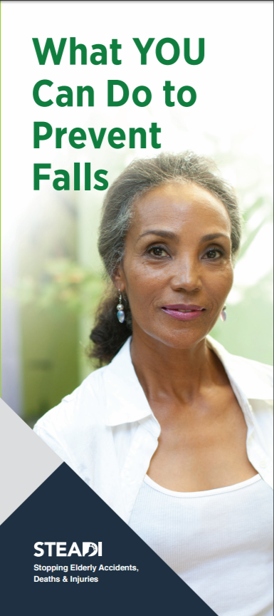
Falls Risk Factors You Can Change TODAY
Have medication reviewed by pharmacist
Be more active!
Find something you enjoy
Do it with a friend
Make your home safer
Optimize vision and footwear
Notes:
We all have different types of risk factors – some we can change and some we cannot. It can be hard to improve the risk factors we can change.
ENGAGE The audience. Ask them what fall risk factors they think can be changed and have a dialogue about that – then go through the slide
Falls are the main reason why older adults loose their independence. The CDC (Centers for Disease Control and Prevention) has a great brochure called Stay Independent. It focuses on 4 main things that you can do to prevent falls.
Exercise and increase your daily activity level to improve you balance and strength
Make your home safer
Have your vision, feet, and footwear checked
Have your doctor or pharmacist review your medicines
The CDC has a lot of great materials and an easy checklist you to gage your own risk for falling and it explains why each of those risk factors matters.
[Presenters we recommend you bring copies of this brochure to the presentation or encourage attendees to download it from the CDC website. You can have them actually score themselves for their own information. Encourage them to talk with their health care professionals about the results.]
We will talk about each of these and how they can be changed as well as your thoughts on how you can decrease your risk factors of falls.

Slide 30
Falls Risk Factors You Can Change TODAY
Use your walker or cane regularly & properly
Go to a community class or physical therapy for:
Strengthening
Balance improvement
Decreased fear of falling
Notes:
We all have different types of risk factors – some we can change and some we cannot. It can be hard to improve the risk factors we can change.
ENGAGE The audience. Ask them what fall risk factors they think can be changed and have a dialogue about that – then go through the slide
Falls are the main reason why older adults loose their independence. The CDC (Centers for Disease Control and Prevention) has a great brochure called Stay Independent. It focuses on 4 main things that you can do to prevent falls.
Exercise and increase your daily activity level to improve you balance and strength
Make your home safer
Have your vision, feet, and footwear checked
Have your doctor or pharmacist review your medicines
The CDC has a lot of great materials and an easy checklist you to gage your own risk for falling and it explains why each of those risk factors matters.
[Presenters we recommend you bring copies of this brochure to the presentation or encourage attendees to download it from the CDC website. You can have them actually score themselves for their own information. Encourage them to talk with their health care professionals about the results.]
We will talk about each of these and how they can be changed as well as your thoughts on how you can decrease your risk factors of falls.

Slide 31
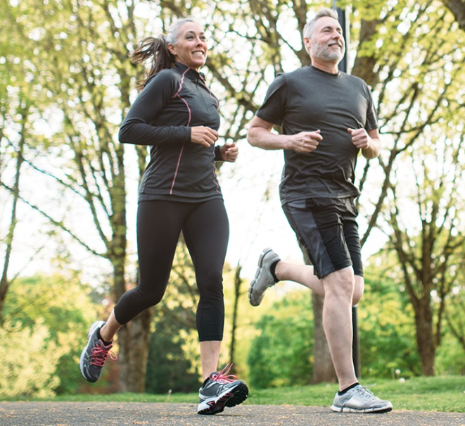
Physical Activity to Prevent Falls
Talk to your doctor before starting an exercise program.
Sit less, move more & find something you enjoy doing!
Go to a physical therapist for individualized treatment on dizziness, strength, balance, moving, walking, and fear of falling
https://www.aarp.org/
Notes:
What are our general exercise recommendations for you? Well first of all always talk with your doctor or healthcare practitioner before starting an exercise program.
We can all due to sit less and move more (myself included!). But it doesn’t have to be aerobics or running– any type of activity helps. For example, even housework and gardening are forms of physical activity. Find something that you enjoy doing to be more active.
POLL the audience ---- What do you all think you can do to increase your daily activity levels and decrease your sitting time?
2. Physical therapists specialize in improving function, strength, and balance. If you don’t feel like group exercise classes are right for you or you want an individualized program for you, see a physical therapist. You do not need to see your doctor first!
3. Participate in fall prevention classes. Be sure the classes you sign up for are designed for your age group or ability level and have an experienced instructor. Let the instructor know you are new to the class when you first arrive.
4. Find a friend or loved one to go with you or for you to report to keep you honest about your attendance.
5. When you find something that works for you, stick with it.

Slide 32
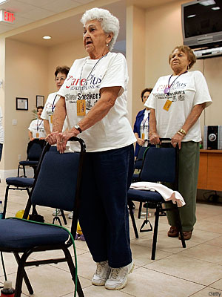
Physical Activity to Prevent Falls
Participate in an ‘evidence based’ fall prevention program Be sure classes are for your age group &/or ability level.
Look for them at Senior Centers, Health Departments, or community centers.
Stick with it!
Find a friend or loved one to help hold you to it!
www.ncoa.org
Notes:
What are our general exercise recommendations for you? Well first of all always talk with your doctor or healthcare practitioner before starting an exercise program.
We can all due to sit less and move more (myself included!). But it doesn’t have to be aerobics or running– any type of activity helps. For example, even housework and gardening are forms of physical activity. Find something that you enjoy doing to be more active.
POLL the audience ---- What do you all think you can do to increase your daily activity levels and decrease your sitting time?
2. Physical therapists specialize in improving function, strength, and balance. If you don’t feel like group exercise classes are right for you or you want an individualized program for you, see a physical therapist. You do not need to see your doctor first!
3. Participate in fall prevention classes. Be sure the classes you sign up for are designed for your age group or ability level and have an experienced instructor. Let the instructor know you are new to the class when you first arrive.
4. Find a friend or loved one to go with you or for you to report to keep you honest about your attendance.
5. When you find something that works for you, stick with it.

Slide 33
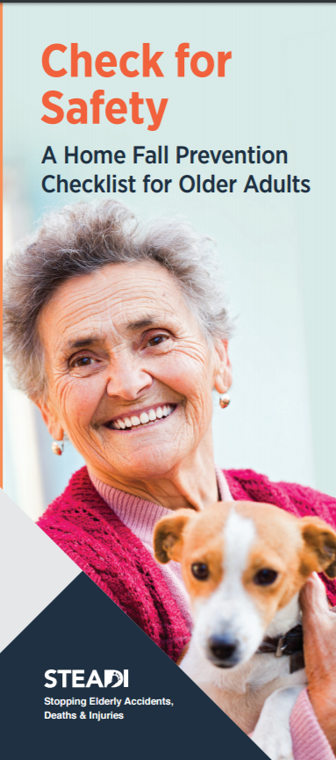
Environmental Recommendations
Identify & eliminate fall hazards in your home & community
Remove potential fall hazards from walkways and stairs
Remove throw rugs or secure rugs safely to the floor
Place frequently used items on a lower shelf, cabinet or counter to avoid using a step stool or ladder
An occupational therapist or physical therapist can help identify safety issues and solutions
Notes:
An important thing that each of you can do to reduce your falls risk is to identify and eliminate fall hazards in your home. To start the process yourself, a helpful brochure is another one from CDC called Check for Safety.
There are lots of hazard checklists available and they generally guide you through your home, room by room. and help you identify potential hazards and some, like this CDC brochure, make recommendations to fix that hazard. For example it will ask you – Do you have throw rugs on the floor? And the recommendation will be to remove the rugs or use double-sided tape or a non-slip backing so the rugs won’t slip and cause you to suffer a fall.
An occupational therapist can also help you identify safety issues in your home and provide individualized solutions based on your abilities and your needs. An occupational therapist is trained to look at safety dangers or things inside and outside your home that may cause you to fall and then give you suggestions to reduce these possible fall risks. The OT would also follow up with you after any modifications are made to your home to make sure you use any new equipment or changes in the environment safely.
You can ask your doctor for a referral to a local occupational therapist if your insurance requires a prescription. Many Home Health agencies have occupational therapists who do this home safety evaluation.

Slide 34
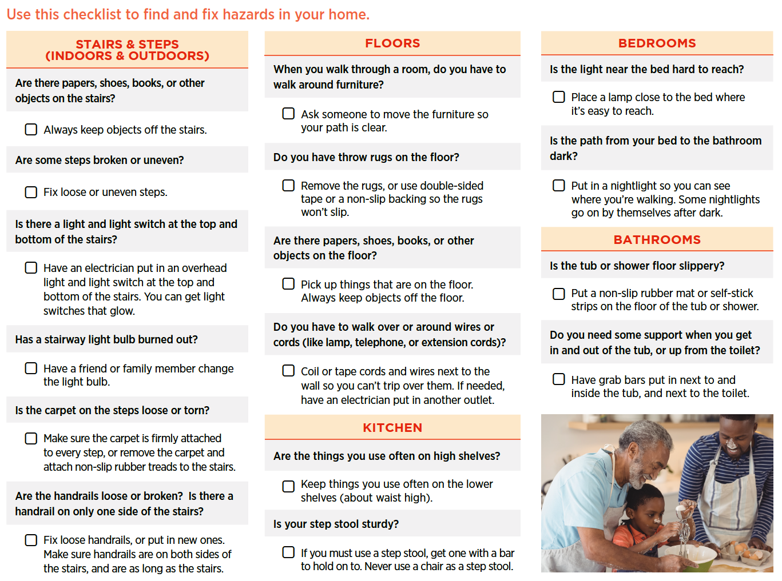
Check for Safety Brochure
Notes:
An important thing that each of you can do to reduce your falls risk is to identify and eliminate fall hazards in your home. To start the process yourself, a helpful brochure is another one from CDC called Check for Safety.
There are lots of hazard checklists available and they generally guide you through your home, room by room. and help you identify potential hazards and some, like this CDC brochure, make recommendations to fix that hazard. For example it will ask you – Do you have throw rugs on the floor? And the recommendation will be to remove the rugs or use double-sided tape or a non-slip backing so the rugs won’t slip and cause you to suffer a fall.
An occupational therapist can also help you identify safety issues in your home and provide individualized solutions based on your abilities and your needs. An occupational therapist is trained to look at safety dangers or things inside and outside your home that may cause you to fall and then give you suggestions to reduce these possible fall risks. The OT would also follow up with you after any modifications are made to your home to make sure you use any new equipment or changes in the environment safely.
You can ask your doctor for a referral to a local occupational therapist if your insurance requires a prescription. Many Home Health agencies have occupational therapists who do this home safety evaluation.

Slide 35
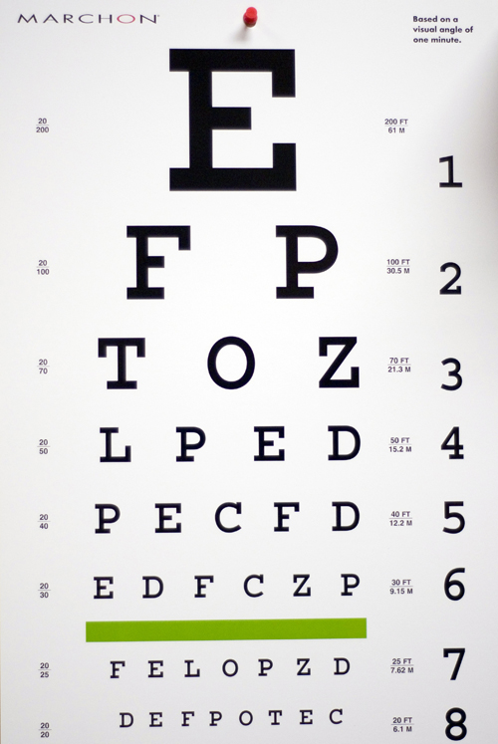
Vision and Falls Risk
Get yearly eye exams after age 50
Bifocals or trifocal lenses may blur or distort your vision looking down
Having cataract(s) removed may reduce fall risk
Use night lights in your hallway and bathroom
http://www.steadmaneye.com/clipart/eyecharts/eye_chart.jpg
Notes:
It is very important to have at least one eye exam every year. If you have vision problems from diabetes, glaucoma, macular degeneration, cataracts or any other eye problem(s) you many need to see your eye doctor more than one time a year.
Your fall risk may decrease if you follow your eye doctor’s recommendation to have cataract surgery, particularly if you are a woman. However, be careful. Falls can increase after cataract surgery due to the change in vision. Be extra cautious as you adjust.
When you first start wearing bifocals, trifocals, or progressive lens, it will take you some time to adjust to how you need to hold your head to see clearly. This is particularly true when going up and down steps or curbs. You may want to hold on to someone’s arm or use the handrail every time you go up/down steps or curbs. If there isn’t a hand rail or someone to hold on to, look around to see if there is a ramp you could use or other way to get to where you want to go.
If this still seems difficult after you think you have gotten used to the glasses, consider wearing two sets of glasses for reading and for distance - particularly for use on stairs or when you get up at night.
Regardless of your vision, Use night lights in your bathrooms and hallways at night to decrease your risk of falls if you get up to go to the bathroom in the middle of the night.

Slide 36
Feet, Footwear, and Falls
Did you know that if you have problems with your feet that increases your risk of falls?
What else about shoes and feet?
If your shoes don’t fit well
Or the soles of your shoes don’t have enough tread
Or you wear socks only around the house!
Are you at an increased risk of falls?
Notes:
Wear good-soled slippers around the house.
See your podiatrist about any foot or shoe problems to decrease your fall risk.

Slide 37
Medications and Falls Risk
Being on more than 4 medications increases your risk of falls
Side effects of blood pressure, sleeping, or other medications may make you dizzy
Medication changes can increase fall risk
Use one pharmacy
Ask for an annual medication review
Be sure you can read your labels
Do not use over the counter medications without discussing with your pharmacist!
Notes:
Medications can cause fall risk. Some medication side effects may make you dizzy, unsteady, or sleepy. Speak with your doctor or pharmacist to see if an other things are available without those side effects.
Use one pharmacy so the pharmacist can be aware of medication interactions, especially if you take more than 4 medications.
Ask your pharmacist or physician to review your medications every year and any time there is a change to your prescription or you are thinking of taking over the counter medications.
Be sure you can read your prescription labels.
Consider using a daily medication box!

Slide 38
Walkers, Canes & Falls “Oh My”
At least half of older adults who use a cane or walker were never measured for fit or trained properly on use.
75% of those who fell WERE NOT USING THEIR PRESCRIBED CANE or WALKER AT THE TIME!
Notes:
Luz C, Bush T, Shen X. Do Canes or Walkers Make Any Difference? NonUse and Fall Injuries. Gerontologist. 2017;57(2):211-218.
Poll the audience –
By a raise of hands:
1. how many of you use a cane or walker?
2. How many of you have been measured to make sure it fits you right and trained to make sure you are using it correctly and safely?
Show slide
Take home – if you have never been measured, fit and trained on using your cane or walker correctly, go see a physical therapist.
If you are supposed to use a cane or walker, make sure you use it, even in your house! DO NOT use walls, furniture, or countertops for balance!

Slide 39
Strength, Balance, & Fear of Falling are NOT 4-Letter Words
Leg strength can be improved to decrease fall risk
If you have a hard time going up the stairs or getting up from a toilet or chair without using your arms, you probably need to strengthen your legs
Balance can be improved to decrease fall risk
If you feel unsteady when walking or just seem to lose your balance for no reason, you probably need to improve your balance.
Notes:
Some pretty reasonable and simple exercises can improve strength and balance

Slide 40
Strength, Balance, & Fear of Falling are NOT 4-Letter Words
What can you do to address both issues?
Physical therapy
Appropriate community-based fall prevention program
Notes:
Some pretty reasonable and simple exercises can improve strength and balance

Slide 41
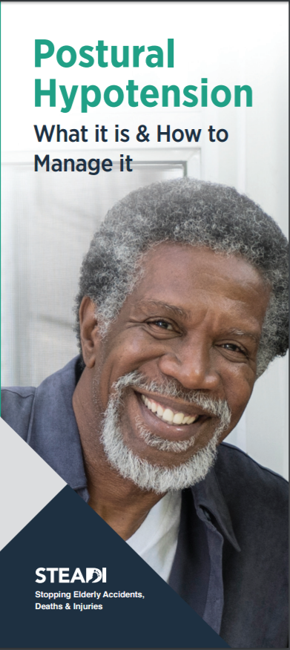
Other Issues: Blood Pressure and Fall Risk
Check your blood pressure checked regularly.
If you get dizzy when you stand up, see your doctor and have your ‘sit to stand’ blood pressure checked.
After sitting up in bed, wait a few minutes before standing
Pump your ankles before getting up to get the blood moving
Some blood pressure medications increase fall risk; speak with your doctor. Be very careful after a beginning a new medication.
Notes:
American Geriatrics Society BGS. AGS/BGS clinical practice guideline: prevention of falls in older persons. 2010.
Have your blood pressure checked regularly. Speak with your doctor about how often to check your blood pressure.
If you get dizzy when you stand up after sitting, see your doctor and have your BP checked for “postural hypotension”.
Some blood pressure medications increase fall risk. Many blood pressure and cardiac medications will initially cause you some dizziness as you change positions. For the first 2-3 weeks after starting a new medication, be especially careful to get up slowly, pump your ankles or move your legs, and count to 3 before standing up. Then stay standing until you are no longer dizzy before you walk to where you need to go.

Slide 42
Risk of Falling May Change With:
Change in your medications
Changes in your health, an illness or infection
New onset of pain
Lack of sleep
Sad or worried
Recent reduction in activity level
Change in use of cane or walker
Change in vision prescription
Move to new home
Notes:
Your chances of falling may increase when you change your medications; if you become sick or have an infection; if your pain level changes.
It can also increase if you are tired, or having ongoing sleeping problems; or if you are sad, worried, depressed, or anxious.
If you have had a reduced activity level or bedrest your legs may be come weak and increase your fall risk. Fear of falling also contributes to the cycle of inactivity, weakness, and increased fall risk.
With the new use of a cane or walker there is an increased risk of falls. Be sure you give yourself plenty of time to learn how to use the new device.
Every time you move to a new physical location your fall risk may increase. Learn your environment slowly. Go to the bathroom on a schedule so there are no emergencies and move with good supportive shoes.

Slide 43
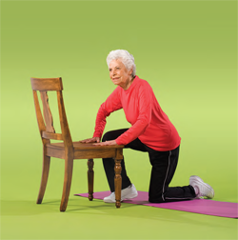
If a Fall Occurs…
DON’T GET UP RIGHT AWAY
Check for injury
Call for help, if needed
Seek medical attention right away if you might have hit your head
Call your doctor
Check for safety hazards to prevent another fall
Your physical therapist can teach you how to safely get up form the floor.
http://www.bing.com/images/search?q=getting+up+from+floor+with+chair+photo&view=detailv2&&id=6078B0575525F1E0A63A99D372BE2F78F77BF411&selectedIndex=0&ccid=U1AEMRPq&simid=608013721659769884&thid=JN.I5Qt1AlQlz9v31ZkHSXKJg&ajaxhist=0
Notes:
What should you do if a fall does occur?
You should:
Check for any injury or serious medical condition; don’t try to get up if you think you have broken your hip, leg, shoulder; instead call for help.
If you think you have hit your head or know you hit your head, seek medical attention right away. This is very important if you are taking blood thinner medication since it may cause you to bleed in your head.
Check the location for safety hazards, wet floor, clutter, lighting, unsafe furniture. Make changes to correct them as soon as possible.
After the fact, you need to report whatever safety hazard you observed to the appropriate people, such as family member, maintenance, housekeeping, or staff in order to fix the hazard so that a fall doesn’t happen again.

Slide 44
In Summary…

Slide 45
In Summary…
Older adults are at an increased risk for falling
Discuss your fall risk and prevention plan with your health care provider
Risk can be modified
Know your risk
Check your home for safety
Discuss your risk factors with your medical doctor or physical therapist
Have your eyes checked at minimum once per year
Exercise to improve your balance and strength

Slide 46
Getting Started
Choose one risk factor to address first:
Pharmacist & Doctor - review medications for side effects that may cause you to fall
Occupational Therapist - home assessment and recommendations to make your home safer
Physical Therapist - help with physical activity, balance, strength, and moving safely
Notes:
There are many things you can do to prevent falls. Start small. Choose one risk factor at a time to address and contact a health professional who can help you address it.
Your pharmacist or doctor can review your medications to look at the side effects that may cause you to fall. There may be other things that will work for you.
An occupational therapist can do a home assessment and give you ideas to make your home safer to help decrease your risk of falling.
A physical therapist can teach you how to use your cane or walker at the proper height; and help with balance, strength, and the ability to walk safely.
Your COA community health educator can help you reach these resources in your community

Slide 47
And then Make a Plan!
What do you plan to do to prevent a fall?
Make a goal
Examples
I will make an appointment with my pharmacist by the end of the week to get my medications checked
My friend and I will start an exercise program and do it twice a week at the local senior center.
I will do the home safety checklist by the end of the month.
I will share my falls risk questionnaire results with my Doctor by the end of the week.
Notes:
Poll the audience

Slide 48
REMEMBER
Move More!

Slide 49
QUESTIONS?

Slide 50
Thank You for Coming!

Slide 51
Evidence-Based Resources
National Council on Aging: Evidence-Based Falls Prevention Programs
https://www.ncoa.org/healthy-aging/falls-prevention/falls-prevention-programs-for-older-adults/
Falls Free® Initiative: Find your state’s chapter
Provides resources and evidence-based practice to reduce fall-related injuries and death among older adults
https://www.ncoa.org/resources/falls-free-coalition-overview/
Notes:
We have listed some evidence based resources for you on line and provided some pamphlets for you as well.
We hope this is a good year for you in working to prevent falls.
Note to presenters – you will need to provide pamphlets as recommended from the STEADI or revise the text.

Slide 52
Need More Information?
A Physical Therapist’s Guide to Falls:
http://www.moveforwardpt.com/symptomsconditionsdetail.aspx?cid=85726fb6-14c4-4c16-9a4c-3736dceac9f0
Remaining in Your Home as you Age:
https://www.aota.org/About-Occupational-Therapy/Patients-Clients/Adults.aspx
The AARP Home Fit Guide:
http://www.aarp.org/livable-communities/info-2014/aarp-home-fit-guide-aging-in-place.html

