Slide 1



10 Years
Standing Together to Prevent Falls
AOTA/APTA’s AGPT
Fall Prevention Presentation 2017
Photo © William Provost
Notes:
Hello and welcome to the annual Fall Prevention Awareness Day fall prevention presentation.
This fall prevention presentation is made possible through the joint efforts of the American Occupational Therapy Association and the American Physical Therapy Association working together with the National Council on Aging.

Slide 2

Are falls preventable?
Photo from giftsandcollectiblesgalore.wordpress.com
Notes:
Many of us want to know - are falls preventable? The simple words “she fell” have a huge impact on us.
We all know someone who has had a fall and experienced significant life changes. But are falls preventable?

Slide 3
YES!
Falls are largely preventable!
Come learn how.
Notes:
The good news is – yes, falls are largely preventable with simple measures. Come learn how.
Notes for presenters to keep in mind, but don’t necessarily need to state:
Falls are experienced by many older adults—a common experience; managing fall risk is a “normal” part of aging. However, falls themselves are NOT a normal part of aging.

Slide 4

Today’s Discussion
Definition of a fall
Fear of falling
Risk factors for falling
Action steps to reduce YOUR fall risk
Illustration © Timurd
Notes:
Today we are going to talk about what a fall and fear of falling are and their impact on us.
We will also talk about what makes an older person more at risk for falls. These are called risk factors.
We will also talk about action steps you can take to reduce your risk of falling.

Slide 5
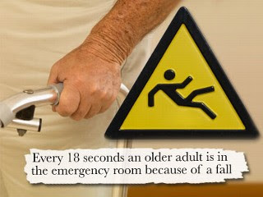
What is a “fall”?
  Landing on the ground or some lower surface when you didn’t intend to be there.
  Includes slips, trips, etc.
  Does not include a medical event.
  Schumway-Cook, 2000
Image from Creative Commons
Notes:
So what is a fall exactly? Landing on the ground or some lower surface when you didn’t intend to is a fall. This includes slips and trips.
Accidents that cause you to fall (like getting run into by a scooter or shopping cart by someone else) are not considered falls.
You do not have to land on the ground to have fallen. For example, if you stand up from a chair and lose your balance and fall back into the chair, that is considered a fall.

Slide 6
Have you had a fall?
Have you had a fall in the past year? Did you tell your primary care provider?
Were you hurt?
Do you worry about falling?
Do you feel unsteady when standing or walking?
A previous fall increases your future fall risk.
Notes:
Have you had a fall in the past year?
Were you hurt?
Do you worry about falling?
Do you feel unsteady when standing or walking?
As we go through the risk factors for falls, think about what might have been the cause of any recent falls that you have had.

Slide 7
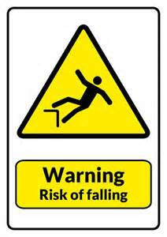
Do you limit activities?
Fear of Falling is a lasting concern about falling that may cause a person to stop doing activities s/he remains able to do.
Fear of falling increases future fall risk.
Tinetti and Powell, 1993
www.bing.com
Notes:
When asked, “Are you afraid of falling?”—many people will say, “No, I’m not afraid, I’m just more careful.” A fear of falling is defined as a lasting concern about falling that may cause a person to stop doing activities s/he remains able to do.
For instance if a person stays in most of the winter because of concerns about a slip on ice, then the ice and fear of falling is limiting their activities and social interaction. This fear of falling is in itself a risk factor for falls.

Slide 8
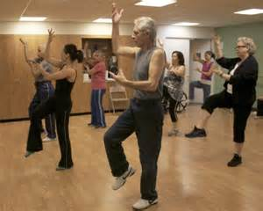
Why does fear of falling matter?
May stop you from activities
Legs weaken with inactivity
Inactivity leads to falls
May make the person feel alone
May cause depression
www.ncoa.org
Boyd & Stevens, 2009; Donoghue, Cronin, Savva, O’Reagan, & Kenny, 2013; Painter, 2012
Notes:
So why does a fear of falling matter to us? Well it can stop a person from doing some of their favorite activities that are important to their mental and physical health.
Legs weaken with inactivity. When we sit, we lose the muscles that we need to use to stand and walk and move. Inactivity leads to falls due to the change in muscle of strength and balance and coordination.
It may make the person feel alone if they cut out the activities that are socially active which can result in depression or anxiety.

Slide 9
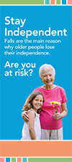
Types of Fall Risk Factors
Most falls result from a number of risk factors:
Physical risk factors: Changes in your body that increase your risk for a fall
Behavioral risk factors: Things we do or don’t do that increase our fall risk
Environmental risk factors: Hazards in our home or community
Notes:
There are three main types of risk factors and we talk about them individually. Most falls experienced by older adults result from the interaction of a number of risk factors. We don’t all have all risk factors. We each have our own set of risk factors.
The physical risk factors are changes in your body that increase your risk for a fall. For instance if you are inactive and you sit and your legs become weak.
Behavioral risk factors are things we do or don’t do that increase our fall risk. This could be taking greater risk like climbing a ladder to remove leaves from the roof and gutters even though at 82 you think it might not be a good idea.
Environmental risk factors are hazard in our home or community. Porch steps without a railing, a toilet that is too low or a tub without grab bars are examples.

Slide 10
Fall Risk Factors
You CAN change:
You CAN’T change:
Physical inactivity
Home environment
Vision
Medication Use
Fear of falling
Social isolation
Weakness
Improper use of assistive devices
Age
Gender
Ethnic background
Notes:
We all have different types of risk factors – some we can change and some we cannot. We are all challenged to improve the risk factors we can change.
We can become physically active; have our home environment evaluated and fixed; get our annual vision checks; make sure our medications are reviewed and considered for fall prevention.
We can deal with fear of falling through education especially using evidence based fall prevention programs that we will talk about later; we can increase our social activity; we can exercise and improve any weak muscles; and we can learn how to use assistive devices that are fit to us and use them the right way.

Slide 11

What can YOU do to prevent falls?
Exercise to improve your balance and strength. It takes 50 hours every 6 months to improve balance.
Have your doctor or pharmacist review your medicines
Have your vision checked
Make your home safer
Notes:
Falls are the main reason why older adults loose their independence. The CDC (Centers for Disease Control and Prevention) has a great brochure called Stay Independent. It focuses on 4 main things that you can do to prevent falls.
Exercise to improve you balance and strength
Have your doctor or pharmacist review your medicines
Have your vision checked
Make your home safer
It also has a checklist for you to gage your own risk for falling and it explains why each of those risk factors matters.
[Presenters we recommend you bring copies of this brochure to the presentation or encourage attendees to download it from the CDC website. You can have them actually score themselves for their own information. Encourage them to talk with their health care professionals about the results.]

Slide 12
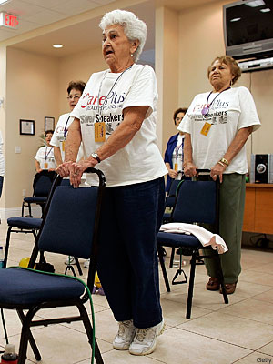
Exercise Recommendations
Talk to your doctor before starting an exercise program.
Begin with PT or fall prevention classes.
Be sure classes are for your age group &/or ability level.
Stick with it!
www.ncoa.org
Notes:
What are our general exercise recommendations for you? Well first of all always talk with your doctor or healthcare practitioner before starting an exercise program.
Begin with PT or fall prevention classes. Be sure the classes you sign up for are designed for your age group or ability level and have an experienced instructor. Let the instructor know you are new to the class when you first arrive.
When you find something that works for you, stick with it.

Slide 13
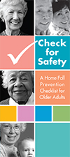
Environmental
Recommendations
Identify and eliminate fall hazards in your home and community
Check for Safety Brochure in CDC’s STEADI Toolkit
An OT or PT can help identify safety issues and solutions
AGS/BGS, 2010; Panel on Prevention, 2011
Notes:
An important thing that each of you can do to reduce your falls risk is to identify and eliminate fall hazards in your home. To start the process yourself, a helpful brochure is another one from CDC called Check for Safety.
There are lots of hazard checklists available and they generally guide you through your home room by room and help you identify potential hazards and some, like this CDC brochure, make recommendations to fix that hazard. For instance, it will ask you – Do you have throw rugs on the floor? And the recommendation will be to remove the rugs or use double-sided tape or a non-slip backing so the rugs won’t slip.
An occupational therapist can also help you identify safety issues in your home and provide individualized solutions based on your abilities and your needs. An occupational therapist is trained to look at safety dangers or things inside and outside your home that may cause you to fall and then give you suggestions to reduce these possible fall risks. The OT would also follow up with you after any modifications are made to your home to make sure you use any new equipment or changes in the environment safely.
You can ask your doctor for a referral to a local occupational therapist if your insurance requires a prescription. Many Home Health agencies have occupational therapists who would be qualified to do this home safety evaluation.

Slide 14

Medications and Falls Risk
  Side effects may make you dizzy
  Medication changes can increase fall risk
  Use one pharmacy.
  Ask for an annual medication review.
  Be sure you can read your labels.
https://d1hekt5vpuuw9b.cloudfront.net/assets/article/fe27
4ef18e93e75562dc05fe87b18316_are-you-taking-too-much
-medicine-580x326_featuredImage.jpg
Notes:
Medications can cause fall risk. Some medication side effects may make you dizzy, unsteady, or sleepy. Speak with your doctor to see if an alternative medication is available without those side effects.
Use one pharmacy so the pharmacist can be aware of medication interactions, especially if you take more than 3 medications. Ask your pharmacist or physician to review your medications annually and any time there is a change to your prescription or over the counter medications.
Be sure you can read your prescription labels.

Slide 15
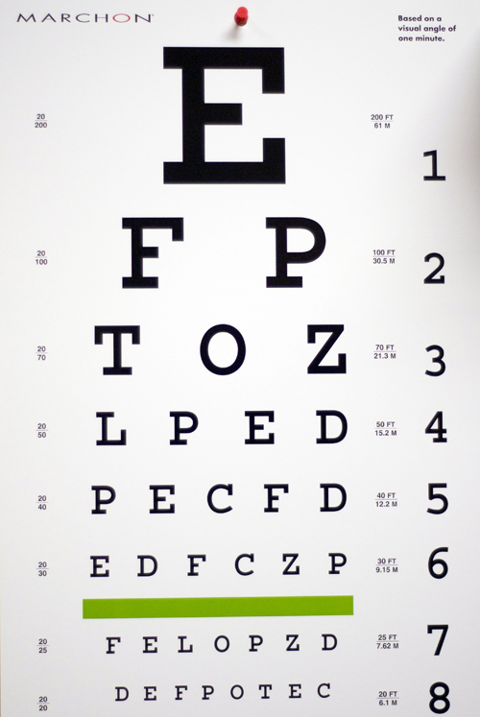
Vision and Falls Risk
Ask for annual eye exams after age 50.
Multifocal lenses may blur or distort your vision looking down. Use separate reading glasses.
Removing cataract(s) may reduce fall risk.
AGS & BGS, 2010
http://www.steadmaneye.com/
clipart/eyecharts/eye_chart.jpg
Notes:
It is very important to have at least one eye exam every year. If you have vision problems from diabetes, glaucoma, macular degeneration, or other eye problem(s) you many need to see your eye doctor more than one time a year.
Your fall risk may decrease if you follow your eye doctor’s recommendation to have cataract surgery, particularly if you are a woman. However, be careful. Falls can increase after cataract surgery due to the change in vision. Be extra cautious as you adjust.
When you first start wearing bifocals, trifocals, or progressive lens, it will take you some time to adjust to how you need to hold your head to see clearly. This is particularly true when going up and down steps or curbs. You may want to hold on to someone’s arm or use the handrail every time you go up/down steps or curbs. If there isn’t a hand rail or someone to hold on to, look around to see if there is a ramp you could use or other way to get to where you want to go. Or consider single vision lenses particularly for use on stairs or when you get up at night.

Slide 16

Blood Pressure and Fall Risk
Check your blood pressure regularly.
If you get dizzy when you stand up, see your doctor and have your ‘sit to stand’ blood pressure checked.
Some blood pressure medications increase fall risk; speak with your doctor. Be very careful after a beginning a new medication.
AGS/BGS, 2010; Panel on Prevention, 2011
Notes:
Have your blood pressure checked regularly. Speak with your doctor about how often to check your blood pressure.
If you get dizzy when you stand up after sitting, see your doctor and have your BP checked for “postural hypotension”.
Some blood pressure medications increase fall risk. Many blood pressure and cardiac medications will initially cause you some dizziness as you change positions. For the first 2-3 weeks after starting a new medication, be especially careful to get up slowly and count to 3 before standing up and walking away from where you were sitting.

Slide 17
Chronic Conditions and
Fall Risk
Chronic Conditions may contribute to your fall risk. Careful management will limit the risk.
  Diabetes
  Arthritis
  Stroke
  Neurological disorders like Multiple Sclerosis (MS) or Parkinson’s
  Chronic Pain
  Depression
  Chronic obstructive pulmonary disease (COPD)
  Sleep disorders
AGS/BGS, 2010; Panel on Prevention, 2011
Notes:
All chronic conditions can impact fall risk in many ways.
Diabetes might change the sensation in your feet.
Arthritis can cause pain that may make you to walk abnormally.
Stroke may cause weakness in one side of your body or change your perception of the environment.
MS, Parkinson’s Disease, and other neurological disorders may affect balance and mobility and increase fall risk.
Chronic pain might cause you to stand in a stooped posture or cause muscle weakness which results in fall risk.
Depression and the medications for depression can both cause fall risk.
Chronic Obstructive Pulmonary Disease (COPD) or anything that changes your lung’s capacity can also cause fall risk, making you dizzy when you move from sitting to standing and also losing oxygen to your brain as you become active. Be careful and speak to your provider about using oxygen during an increase in physical activity.

Slide 18
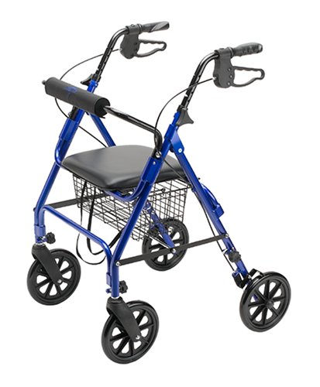
Risk of Falling May Increase
Change in your medications
Illness or infection
Pain
Lack of sleep
Sad or worried
Reduced activity level
Change in use of cane or walker
Move to new home
http://www.opinionscentral.com/wp-content/uploads/
2015/05/Medline-Folding-
Rollator-Walker-with-Folding-8-inch-Wheel.jpg
Photo © Aprescindere
Notes:
Your chances of falling may increase when you change your medications; if you become sick or have an infection; if your pain level changes.
It can also increase if you are tired, or having ongoing sleeping problems; or if you are sad, worried, depressed, or anxious.
If you have had a reduced activity level or bedrest your legs may be come weak and increase your fall risk. Fear of falling also contributes to the cycle of inactivity, weakness, and increased fall risk.
With the new use of a cane or walker there is an increased risk of falls. Be sure you give yourself plenty of time to learn how to use the new device.
Every time you move to a new physical location your fall risk may increase. Learn your environment slowly. Go to the bathroom on a schedule so there are no emergencies and move with good supportive shoes.

Slide 19
Start Small
  Choose one risk factor to address first ---
  Pharmacist & Doctor - review medications for side effects that may cause you to fall
  Occupational Therapist - home assessment and recommendations to make your home safer
  Physical Therapist - help with physical activity, balance, strength, and moving safely
Notes:
There are many things you can do to prevent falls. Start small. Choose one risk factor to address and contact a health professional who can help you address it.
Your pharmacist or doctor can review your medications to look at the side effects that may cause you to fall. There may be alternated medications that will work for you.
An occupational therapist can do a home assessment and give you ideas to make your home safer to help decrease your risk of falling.
A physical therapist can teach you how to use your cane or walker at the proper height; and help with balance, strength, and the ability to walk safely.

Slide 20
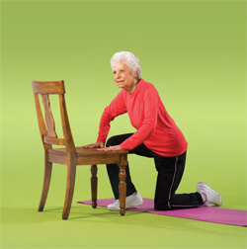
If a Fall Occurs ……
Check for injury
Call for help, if needed
Seek medical attention right away if you might have hit your head
Call your doctor
Check for safety hazards
Learn how to get up safely from your physical therapist
http://www.bing.com/images/search?q=getting+up+from+floor+with+chair+photo&view=detailv2&&id=6078B0575525F1E0A63A99D372BE2F78F77BF411&selectedIndex=0&ccid=U1AEMRPq&simid=608013721659769884&thid=JN.I5Qt1AlQlz9v31ZkHSXKJg&ajaxhist=0
Notes:
What should you do if a fall does occur?
You should:
Check for any injury or serious medical condition; don’t try to get up if you think you have broken your hip, leg, shoulder; instead call for help.
If you think you have hit your head or know you hit your head, seek medical attention right away. This is very important if you are taking blood thinner medication since it may cause you to bleed in your head.
Check the location for safety hazards, wet floor, clutter, lighting, unsafe furniture. Make changes to correct them as soon as possible.
After the fact, you need to report whatever safety hazard you observed to the appropriate people, such as family member, maintenance, housekeeping, or staff in order to fix the hazard so that a fall doesn’t happen again.

Slide 21
Evidence-Based
Fall Prevention
Programs
Notes:
Evidence-based means that there is research that shows that the program is effective in preventing falls. The CDC has identified a number of evidence-based fall prevention programs that are intended to decrease falls and injuries from falls.
We want to tell you about some of those programs and encourage you to find one in your area or talk to your doctor or health care provider about a program that is right for you.

Slide 22
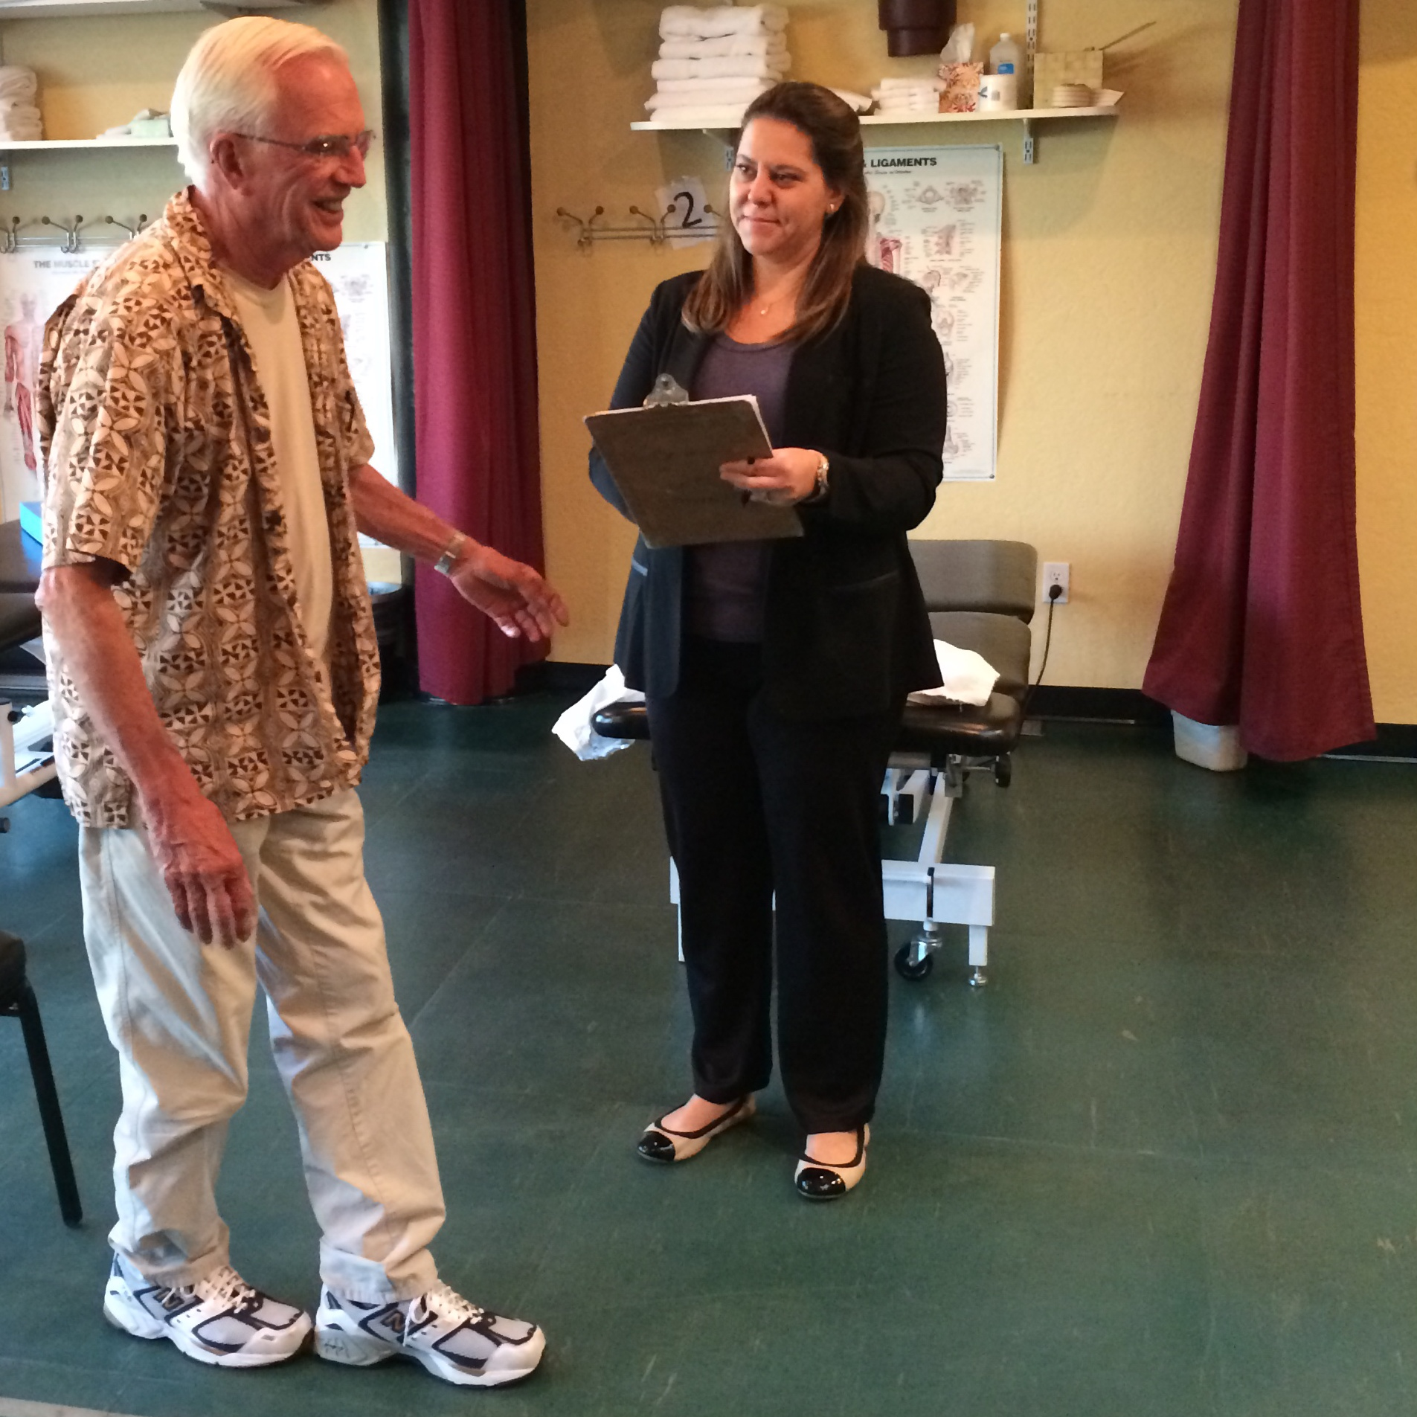
Otago Exercise
Program(OEP)
Done one-to-one with a trained PT and is delivered as part of a complete PT program. Sometimes used in small groups with a PT/PTA.
Includes exercise and walking program designed for you.
If you or your physician feel you should begin with PT, be sure your PT includes the OEP.
Great start for later Stepping On® (SO) program.
Notes:
The Otago is one evidence based exercise program. This particular program is done one to one by a trained PT and is delivered as part of a complete PT program. Therefore this program will be paid by Medicare and other insurances which is a nice added benefit.
It includes exercise and a community walking program that are designed for you from a menu of exercises that your PT chooses based upon your particular needs.
If you or your physician feel you should begin with PT, be sure your PT includes the OEP
Otago is great start for later taking a Stepping On program and is especially helpful for people who are not quite ready to exercise on their own without someone holding on.
Photo release on file with www.ncoa.org
Visit http://news.unchealthcare.org/news/2013/september/the-otago-exercise-program-reduces-falls-among-older-adults

Slide 23

Matter of Balance
Includes eight weekly 2-hour sessions including peer group discussion, exercise, education and some behavior modification.
Excellent for people who are fearful of falling.
All exercises can be done in sitting or supported standing.
Great start for later Stepping On.
Visit http://www.mainehealth.org/mob
http://www.ptrc.org/modules/show
image.aspx?imageid=307
Notes:
Is a community based group class that includes 8 weekly 2 hour sessions, including peer discussions, gentle exercise, education, and some behavior modification.
It is particularly aimed at people who have a significant fear of falling. All of the exercises can be done in sitting or supported standing and therefore do not require the same level of mobility as some other programs. It is a great start for later Otago or Stepping On programs.

Slide 24
Stepping On® (SO)
Seven weekly 2-hour classes including peer discussion, exercise, expert lectures
Great follow-up to Otago (OEP) &/or Matter of Balance
SO classes include standing exercises that are done by a chair independently in class and at home
You should feel safe standing and walking independently before you begin SO
Visit https://wihealthyaging.org/stepping-on
Notes:
Stepping On is also a community based group class that is 7 weekly 2-hour classes including peer discussion, exercise, and weekly expert lectures. It is a great follow up to Otago exercises with your PT.
Stepping On classes include standing exercises that are done by a chair independently and may tax your balance and strength a little more than Otago and Matter of Balance. You should feel safe standing and walking independently before you begin Stepping On.
Visit https://wihealthyaging.org/stepping-on

Slide 25
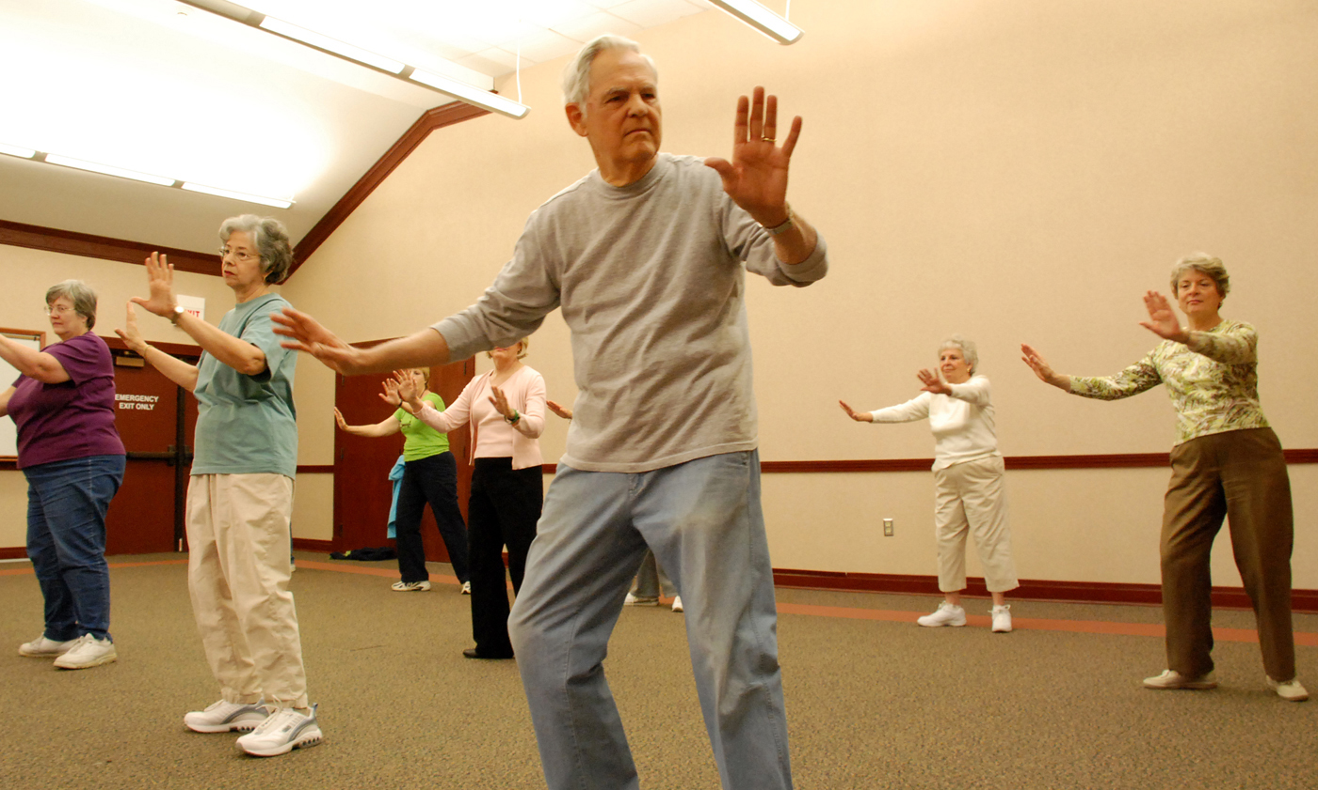
Tai Chi or Tai Ji Quan
Fantastic program for ongoing fitness and balance training after Stepping On
Does not include educational component
Classes are usually on-going and not limited to certain weeks – great for fitness
Participants should be able to stand on one leg for 3-5 seconds
http://www.bing.com/images/search?q=tai+chi+photo&view=detailv2&&id=345A0D1407222D9168D9AD533BA7FB80518FB735&selectedIndex=83&ccid=%2f6oTeds2&simid=608050211697264102&thid=JN.K6cjrIjTNIh3wOKQUJ9cCg&ajaxhist=0
Notes:
Tai Chi is a fantastic program for ongoing fitness and balance training after you have completed Stepping On and/or your community walking program.
It does not include an educational component, nor is it limited in length. Classes are usually ongoing and not limited to certain weeks so it is great for ongoing fitness.
Participants should be able to stand on one leg for more than 5 or more seconds, not be fearful of falling, and have an active lifestyle
Tai Chi has been shown to have remarkable benefits including, decreased fall risk, decreased stress, improvements in existing medical conditions, and improved mental health.
If you have low fall risk, have not had falls in the past year and have been quite active, Tai Chi is an excellent choice for your health and to maintain a low fall risk. There are seated Tai Chi classes and regular standing Tai Chi classes. If you cannot stand on one leg > 5 sec, begin with seated Tai Chi (pictured here) and/or Stepping On.
Notes for speakers only
Increases flexibility and muscle strength (Tsang, et. al., 2004; Wu, et al., 2002)
Improves balance (Tsang, et. al., 2004; Wu, et al., 2002)
Improves gait (Tsang, et. al., 2004; Wu, et al., 2002)
Improves posture (Liam, 2006;Tsang, et. al., 2004; Wu, et al., 2002)
Improves body awareness (American Arthritis Foundation, 2008)
Improves health and fitness (American Arthritis Foundation, 2008; Liam, 2006)

Slide 26

Finding Evidence-Based
Falls Prevention Programs
Local Senior Center
Area Agency on Aging www.eldercare.gov or
1-800-677-1116
Hospitals or health clinics
YMCA for programs like Tai Chi
http://www.triadlocalfirst.com/sites/d
efault/files/tlfadmin/green_phone.png
Notes:
Sometimes the greatest challenge is just finding the evidence based fall prevention program in your area.
Call or visit your local senior center as a start.
If you don’t come up with info there your local Area Agency on Aging or at www.eldercare.gov should be able to steer you in the right direction.
Your County Council on Aging or Department of Public Health may also offer programs or know where they are.
Hospitals often have educational programs onsite or you can contact your YMCA for programs like Tai Chi.
Check the websites of the fall prevention programs themselves that we have listed in this program.
Speaker: Distribute local list of classes/resources here.

Slide 27
REMEMBER:
Move More!
Notes:
The bottom line is if you move more, your body will be stronger and fitter and have a decrease fall risk.
Find something you enjoy and go for it.

Slide 28

Questions/Discussion

Slide 29
Evidence-Based Resources
National Council on Aging: Evidence-Based Falls Prevention Programs
  https://www.ncoa.org/healthy-aging/falls-prevention/falls-prevention-programs-for-older-adults/
Falls Free® Initiative: Find your state’s chapter
  Provides resources and evidence-based practice to reduce fall-related injuries and death among older adults
  https://www.ncoa.org/resources/falls-free-coalition-overview/
Notes:
We have listed some evidence based resources for you on line and provided some pamphlets for you as well.
We hope this is a good year for you in working to prevent falls.
Note to presenters – you will need to provide pamphlets as recommended from the STEADI or revise the text.

Slide 30
Thank You for Coming!

Slide 31
Need more information?
A Physical Therapist’s Guide to Falls:
http://www.moveforwardpt.com/symptomsconditionsdetail.aspx?cid=85726fb6-14c4-4c16-9a4c-3736dceac9f0
Remaining in Your Home as you Age:
https://www.aota.org/About-Occupational-Therapy/Patients-Clients/Adults.aspx
The AARP Home Fit Guide:
http://www.aarp.org/livable-communities/info-2014/aarp-home-fit-guide-aging-in-place.html

Slide 32
References
Ambrose, A. F., Paul, G., & Hausdorff, J. M. (2013). Risk factors for falls among older adults: A review of the literature. Maturitas, 75, 51-61.
American Geriatrics Society & British Geriatrics Society [AGS & BGS] (2010). Clinical Practice Guideline: Prevention of Falls in Older Persons.
Boyd, R., & Stevens, J. A. (2009). Falls and fear of falling: Burden, beliefs and behaviours. Age and Ageing, 38, 423–428. http: //dx.doi.org/10.1093/ageing/afp053
Centers for Disease Control and Prevention (CDC), (2014a). Falls among older adults: An overview. Retrieved from http://www.cdc.gov/HomeandRecreationalSafety/Falls/adultfalls.html
Donoghue, O. A., Cronin, H., Savva, G. M., O’Reagan, C., & Kenny, R. A. (2013). Effects of fear of falling and activity restriction on normal and dual task walking in community dwelling older adults. Gain & Posture, 38, 120-124.

Slide 33
References
Grundstrom, A. C., Guse, C. E., & Layde, P. M. (2012). Risk factors for falls and fall-related injuries in adults 85 years of age and older. Archives of Gerontology and Geriatrics, 54, 421-428. doi: 10.1016/j.archger.2011/06.008
Kalyani, R. R., Stein, B., Valiyil, R., Manno, R., Maynard, J. W., & Crews, D. C. (2010). Vitamin D treatment for the prevention of falls in older adults: Systematic review and meta-analysis. Journal of the American Geriatrics Society, 58, 1299–1310. DOI: 10.1111/j.1532-5415.2010.02949.x
Liam, P. & Kaye, N. (2006). Tai chi for beginners and the 24 forms. Louisville, KTY: Four Colour Imports.
Nye, A. (2012). Preventing Medicattion-related falls. Presentation at the Emergency care conference, Greenville, NC
Painter, J., et al. (2012). Fear of falling and its relationship with anxiety depression, and activity engagement among community-dwelling older adults. AJOT, 66, 169-176.
Panel on Prevention … (2011). Summary of the updated AGS/BGS clinical practice guideline for prevention of falls in older persons. JAGS, 59, 148-157.

Slide 34
References
Shumway-Cook, A, Brauer, S, & Woollacott,M. (2000). Predicting the probability for falls in community-dwelling older adults using the Timed Up & Go Test. Phys Ther, 80(9), 896-903.
Stevens, J. A. (2010). CDC Compendium of effective fall interventions: What works for community-dwelling older adults, 2nd Edition. Retrieved from: http://www.cdc.gov/homeandrecreationalsafety/Falls/compendium.html
Stevens, J. A. & Rudd, R. A. (2014). Circumstances and contributing causes of fall deaths among person aged 65 and older.: United States, 2010. JAGS, 62, 470-475. doi: 10.111/jgs.12702
Tinetti, M., Richman, D., & Powell, L. (1990). Falls efficacy as a measure of fear of falling. Journal of Gerontology, 45, 239-243.
Tinetti, M. E., & Powell L. (1993). Fear of falling and low self-efficacy: a case of dependence in elderly persons. Journal of Gerontology, 48, 35-38.
WHO Organization (2010). Falls Fact Sheet N.344 Retrieved from: http://www.who.int/mediacentre/factsheets/fs344/en/index.html

